Slide 1
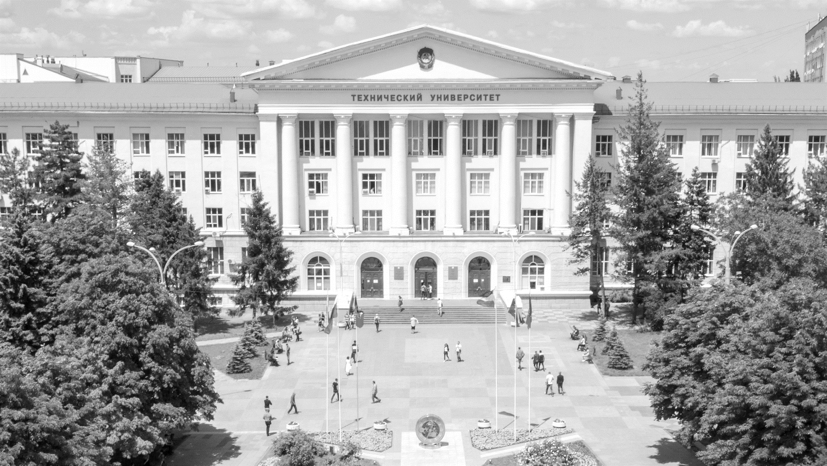
THE MINISTRY FOR SCIENCE AND HIGHER EDUCATION OF THE RUSSIAN FEDERATION
DON
STATE
TECHNICAL UNIVERSITY
DON STATE TECHNICAL UNIVERSITY
www.donstu.ru

Slide 2
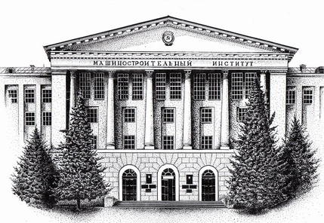
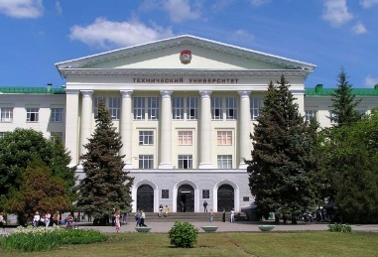
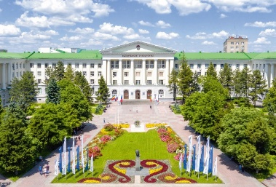
DON STATE TECHNICAL UNIVERSITY
5
branches
1930
North-Caucasus Institute of Agricultural Machinery Building
5 000+
staff
Don
State
Technical
University
46 000+
students
1992
134
departments
3 000+
international
students
24
faculties
341
study programs
2016
The Flagship University
DON STATE TECHNICAL UNIVERSITY www.donstu.ru

Slide 3
EUROPEAN DIPLOMA SUPPLEMENT
ДОНСКОЙ
ГОСУДАРСТВЕННЫЙ
ТЕХНИЧЕСКИЙ
УНИВЕРСИТЕТ
EUROPEAN DIPLOMA SUPPLEMENT
It is an international supplement to the diploma, the requirements for the structure of which are developed by the European Commission together with the Council of Europe and UNESCO
It is necessary for graduates to enroll in foreign universities.
It is interesting for foreign companies while employing new staff members
The number of hours of subjects in curriculum is presented in ECTS (European Credit Transfer System) credits, which makes it easy to compare it with diplomas of foreign universities
European Diploma Supplement is accepted by both Asian and American universities
DON STATE TECHNICAL UNIVERSITY www.donstu.ru

Slide 4
EUROPEAN DIPLOMA SUPPLEMENT
ДОНСКОЙ
ГОСУДАРСТВЕННЫЙ
ТЕХНИЧЕСКИЙ
УНИВЕРСИТЕТ
EUROPEAN DIPLOMA SUPPLEMENT
The result of more than 20 years of work by UNESCO and the Council of Europe together with leading European universities
As a result, a single document was developed that now allows to unify information about education and received professional competencies
DON STATE TECHNICAL UNIVERSITY www.donstu.ru

Slide 5
EUROPEAN DIPLOMA SUPPLEMENT
HOW DOES THE EUROPEAN DIPLOMA SUPPLEMENT CORRELATES WITH RUSSIAN EDUCATION DOCUMENTS?
ДОНСКОЙ
ГОСУДАРСТВЕННЫЙ
ТЕХНИЧЕСКИЙ
УНИВЕРСИТЕТ
It is issued in English, which makes it understandable to foreigners
It allows to understand subjects and exact period of the graduate’s study, his or her results and qualifications obtained at the end of training
The number of training hours is given in European units ("credits")
Russian grades are transferred to their European counterparts (from A to F)
There is information about the average grade of the graduate, the name of all course projects, works, internships, academic mobility, his or her academic and professional rights
Comprehensive information about DSTU and Russian education system is provided
DON STATE TECHNICAL UNIVERSITY www.donstu.ru

Slide 6
EUROPEAN DIPLOMA SUPPLEMENT
ДОНСКОЙ
ГОСУДАРСТВЕННЫЙ
ТЕХНИЧЕСКИЙ
УНИВЕРСИТЕТ
HAVING THIS SUPPLEMENT YOU CAN:
continue studying abroad with the transfer of disciplines
get a job abroad under an accelerated qualification recognition procedure
get a job in a foreign company that has a representative office in Russia, also under the accelerated procedure of recognition of qualifications
EUROPEAN DIPLOMA SUPPLEMENT IS:
a personal document that describes the nature, essence, level, context, content and status of the training that was successfully completed by the one who was awarded the main diploma to which the Application relates
it does not substitute fot the main diploma and does not give the right to formal recognition of the original diploma by the academic authorities of other countries
DON STATE TECHNICAL UNIVERSITY www.donstu.ru

Slide 7
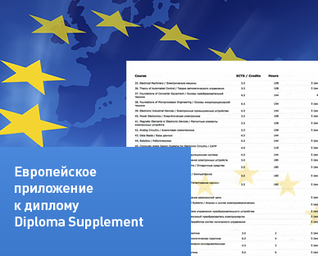
WHAT DOES NOT EQUAL TO EUROPEAN DIPLOMA SUPPLEMENT?
ДОНСКОЙ
ГОСУДАРСТВЕННЫЙ
ТЕХНИЧЕСКИЙ
УНИВЕРСИТЕТ
EUROPEAN DIPLOMA SUPPLEMENT
Is not a Curriculum Vitae (CV)
Is not a substitution for the original document of education
Is not an automatic guarantee for recognition the original document of education
DON STATE TECHNICAL UNIVERSITY www.donstu.ru

Slide 8
EUROPEAN DIPLOMA SUPPLEMENT ENSURES
ДОНСКОЙ
ГОСУДАРСТВЕННЫЙ
ТЕХНИЧЕСКИЙ
УНИВЕРСИТЕТ
EUROPEAN DIPLOMA SUPPLEMENT
International «transparency»
Fair recognition
Adaptation to fast change in qualifications
Mobility
Accessibility of education
Lifelong learning
Clear assessment of qualifications
Accurate description of the individual learning plan and acquired competencies
DON STATE TECHNICAL UNIVERSITY www.donstu.ru

Slide 9
EUROPEAN DIPLOMA SUPPLEMENT CONTAINS SECTIONS:
ДОНСКОЙ
ГОСУДАРСТВЕННЫЙ
ТЕХНИЧЕСКИЙ
УНИВЕРСИТЕТ
European supplement holder’s personal information
Information about acquired qualification
Information about qualification level
Information about the content of the program and obtained results. The results of students ' training are given taking into account the national and European assessment systems, the intensity of disciplines in academic hours is translated into the system of European units — "credits“
Information about qualifications’ functions
Additional information about university
Certification of the supplement
Information of national system of higher education
DON STATE TECHNICAL UNIVERSITY www.donstu.ru

Slide 10
WHAT DOCUMENTS ARE REQUIRED?
ДОНСКОЙ
ГОСУДАРСТВЕННЫЙ
ТЕХНИЧЕСКИЙ
УНИВЕРСИТЕТ
EUROPEAN DIPLOMA SUPPLEMENT
A copy of the diploma and the diploma supplement certified by DSTU General Department (office 242, main building)
Student’s study card (issued at the Dean’s office)
Passport copy
Foreign passport copy (if has)
Receipt of payment (4000 rub.)
DON STATE TECHNICAL UNIVERSITY
Responsibility and operation of the process:
DSTU CENTER OF CONSULTING AND MONITORING OF INTERNATIONAL EDUCATION
https://donstu.ru/structure/administrative/sluzhby-po-mezhdunarodnoy-deyatelnosti/tsentr-konsaltinga-i-monitoringa-mezhdunarodnogo-obrazovaniya-/
CONTACTS
tel. +7 (863) 273-84-23, 238-13-78
Monday-Friday 9.00 – 13.00, 14.00-17.00
Gagarin sq. , 1, build. 8, 5 floor., office 551
e-mail: roseland2003@mail.ru
DON STATE TECHNICAL UNIVERSITY www.donstu.ru

Slide 11
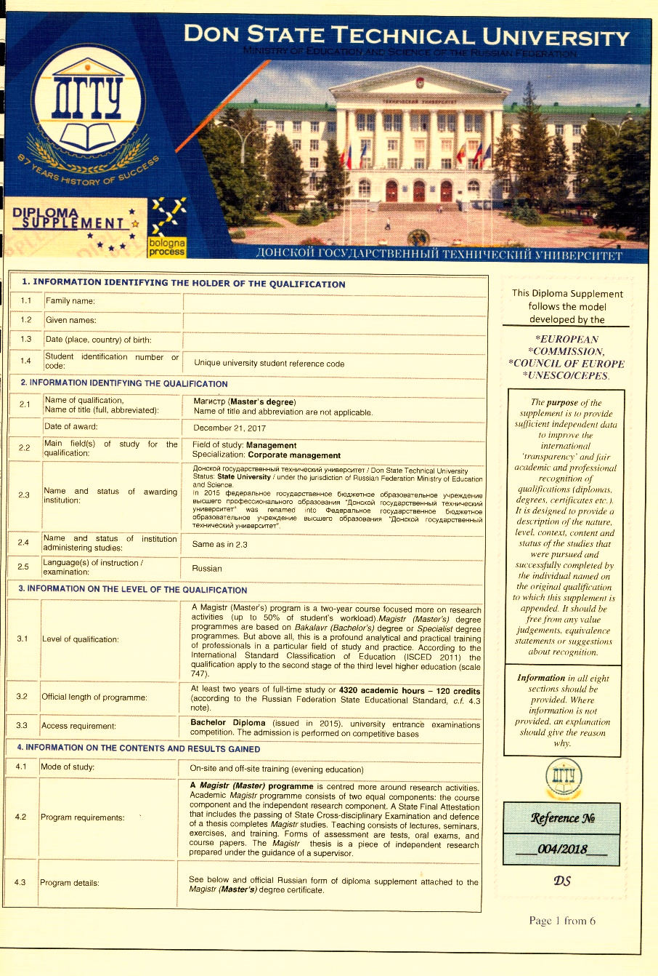
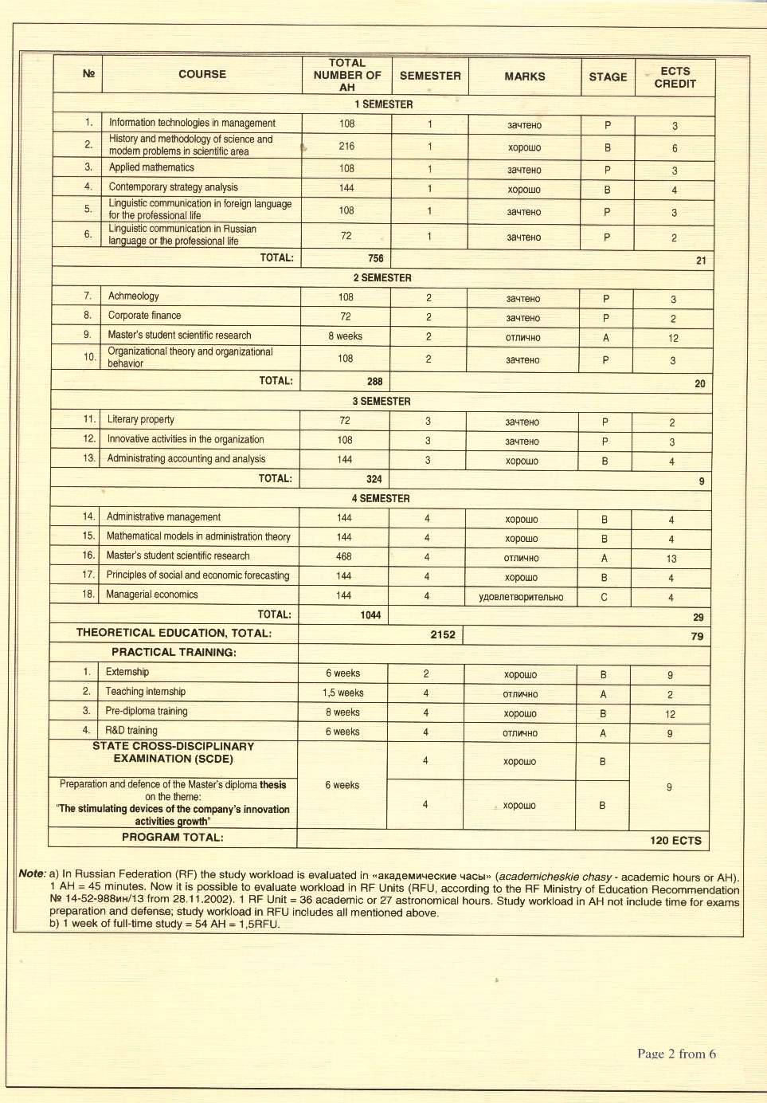
A SAMPLE OF EUROPEAN DIPLOMA SUPPLEMENT FOR MASTER’S DEGREE
ДОНСКОЙ
ГОСУДАРСТВЕННЫЙ
ТЕХНИЧЕСКИЙ
УНИВЕРСИТЕТ
DON STATE TECHNICAL UNIVERSITY www.donstu.ru

Slide 12
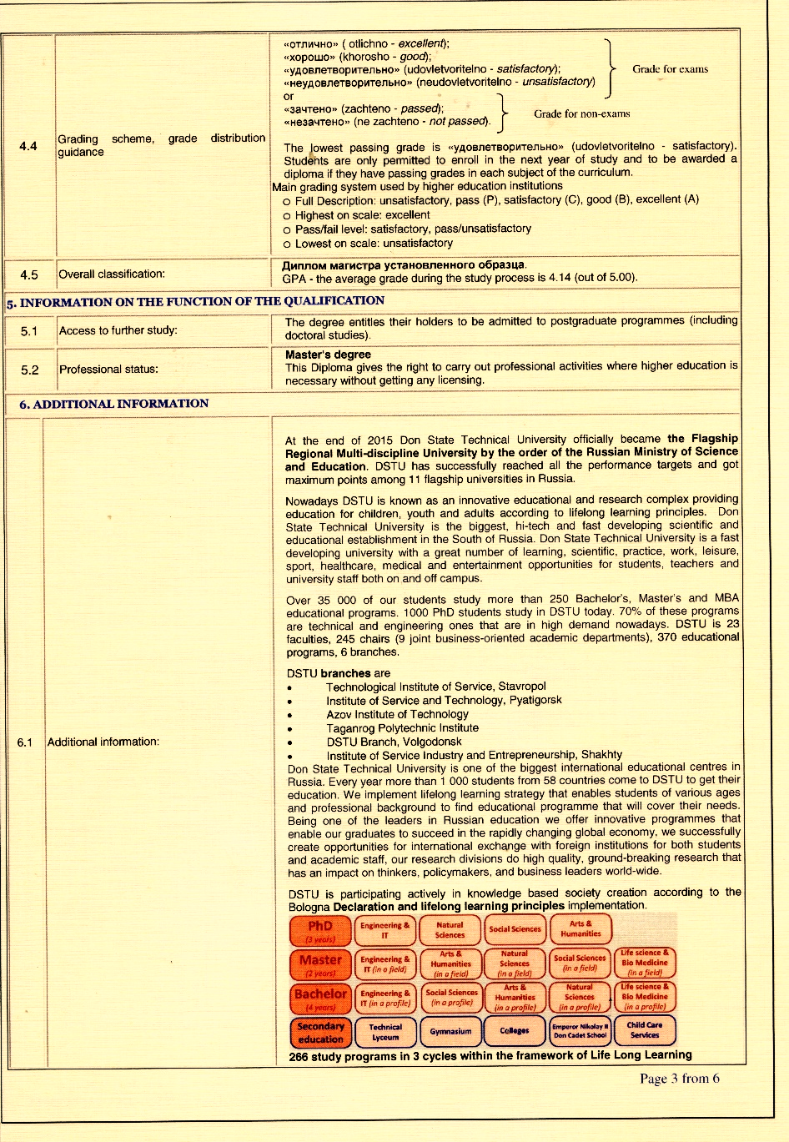
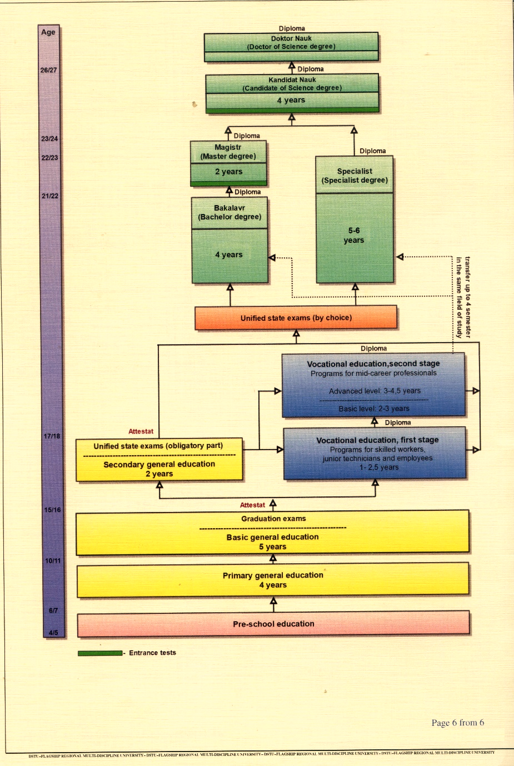
A SAMPLE OF EUROPEAN DIPLOMA SUPPLEMENT FOR MASTER’S DEGREE
ДОНСКОЙ
ГОСУДАРСТВЕННЫЙ
ТЕХНИЧЕСКИЙ
УНИВЕРСИТЕТ
DON STATE TECHNICAL UNIVERSITY www.donstu.ru

Slide 13
THE MINISTRY FOR EDUCATION AND SCIENCE OF THE RUSSIAN FEDERATION
DON
STATE
TECHNICAL UNIVERSITY
THANK YOU FOR YOUR
ATTENTION!
www.donstu.ru

